Slide 1


Slide 2

RHEUMATOID
ARTHRITIS
(RA)
Dr. M Jokar
www.doctorjokar.com

Slide 3
RA - Definition
Chronic systemic inflammatory disorder
Unknown etiology
Synovium affected
Joint Deformity
Extra-articular manifestations

Slide 4
RA - Epidemiology
Worldwide distribution
All races
female > male 3:1
Prevalence: 0.5%
The most common Inflammatory disorder of joint
All ages (peak 35-55)

Slide 5
RA Epidemiology
Direct costs
A mean of $ 5720 / person / year

Slide 6
RA Epidemiology
Indirect costs
$ 26-32 billion per year in USA

Slide 7
RA Epidemiology
Intangible costs
(Impacts in all aspects of quality of life)
Restriction of activities of daily living in two thirds
  Requiring help from family or friends
Patient’s time spent related to their health care
Side effects related to treatments & co-morbid conditions

Slide 8
Causes
The cause of rheumatoid arthritis is unk nown
Several factors have been identified that may lead to its cause
  Genetic factors
  Environmental factors
  Hormonal factors

Slide 9
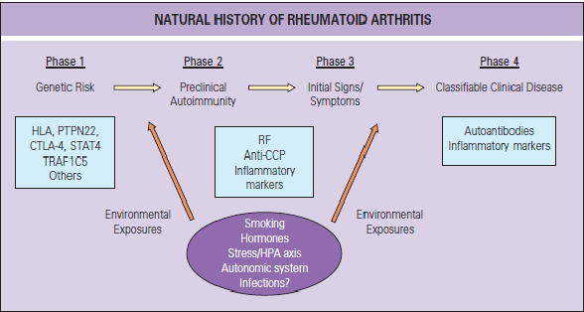

Slide 10
Clinical manifestations
Articular
Nonarticular

Slide 11
Articular Features
Pain
Swelling
Tenderness
Warmth (large joints)
Stiffness
Redness is rare
Symmetrical polyarthritis
Deformity

Slide 12
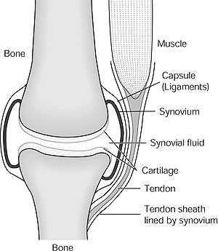
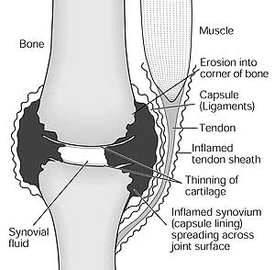
Normal versus infected joint

Slide 13
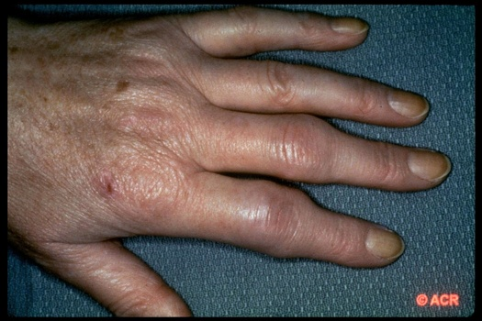
Rheumatoid Arthritis

Slide 14
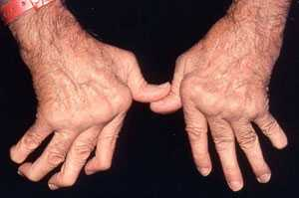

Slide 15
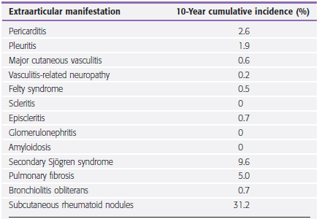

Slide 16
Laboratory findings
CBC: Anemia of moderate degree
ESR ↑
C-reactive protein ↑
RF 70% but not specific
Anti-CCP

Slide 17
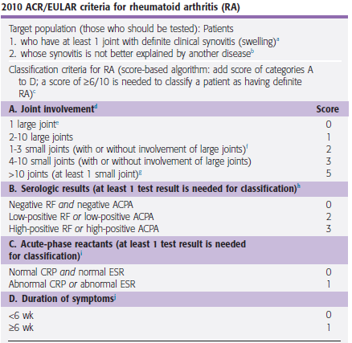

Slide 18
General principles of management
Early diagnosis
Care by an expert in the treatment of rheumatic diseases
Early use of DMARDs
Tight control

Slide 19
Treatment
Goals
Relief of pain
Reduction or suppression of inflammation
Minimizing undesirable side effects
Preservation of muscle and joint function
Return to a desirable and productive life

Slide 20
    RA – Management
    Nonpharmacologic
●Patient education
●Psychosocial interventions
●Rest, exercise, and physical and occupational therapy
●Nutritional and dietary counseling
●Interventions to reduce risks of cardiovascular disease, including smoking cessation, and of osteoporosis
●Immunizations

Slide 21
Pretreatment evaluation
CBC, creatinine, aminotransferases, ESR and CRP in all patients
Serologic testing for hepatitis prior to methotrexate, leflunomide, or biologic DMARDs
PPD
Ophthalmologic screening for hydroxychloroquine use

Slide 22
Medications
There are four types of medications used to treat RA:
  NSAIDs
  Corticosteroids
  Disease-modifying anti-rheumatic drugs(DMARDS).
  Bioligics

Slide 23
Choice of therapy
●Level of disease activity (eg, mild versus moderate to severe)
●Stage of therapy (eg, initial versus subsequent therapy in patients resistant to a given intervention)
●Regulatory restrictions (eg, governmental or health insurance company coverage limitations)
●Patient preferences (eg, route and frequency of drug administration, monitoring requirements, personal cost)

Slide 24
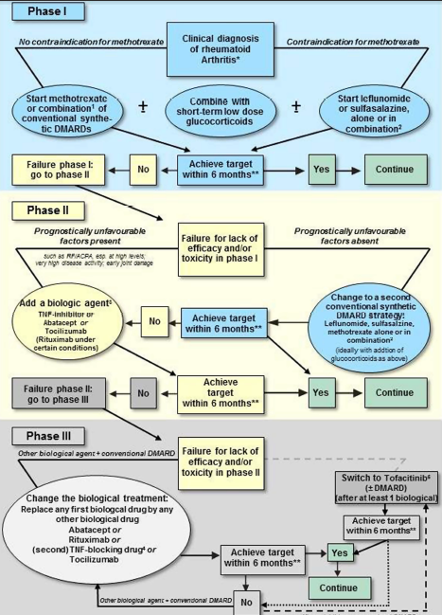

Slide 25
NSAIDs

Slide 26
Familiar NSAIDs
Acetylsalicylic acid
Ibuprofen
Naproxen
Indomethacin
Diclofenac
Piroxicam
Celecoxib

Slide 27
NSAID Effects
Complete effects are achieved in two weeks in acute inflammatory conditions
Analgesia achieved with 50% - 75% dosage needed for anti-inflammatory effects

Slide 28
Side Effects
In 2001:
  100,000 hospitalizations (estimated)
  17,000 deaths (estimated)
  $2 billion dollars in medical care

Slide 29
Side Effects
GI Irritation
Renal Damage
Liver Damage
Anemia
Skin reactions
CNS Effects

Slide 30
Corticosteroids

Slide 31
Steroids:
The worst drugs for adverse effects

Slide 32
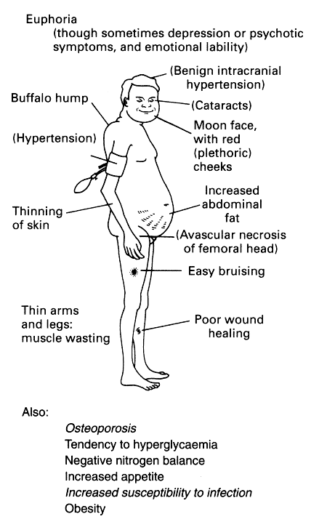

Slide 33
Glucocorticoids
Balance the ratio of benefit / risk before the use of GCs !!!

Slide 34
Glucocorticoids
Rapidly reduce symptoms
long-term treatment with glucocorticoids should be avoided
Intraarticular

Slide 35
Disease modifying agents
Every patient should be considered for at least one modifying agent
Methotrexate
Antimalaria
Sulfasalasine
Leflunomide
Biologic agents

Slide 36
Methotrexate
The DMARD of choice for the initial treatment
If the response to appropriate doses of MTX monotherapy is inadequate after three to six months, initiate combination therapy
In patients unable to take MTX, use monotherapy with a tumor necrosis factor (TNF) inhibitor (eg, etanercept or infliximab), leflunomide or SSZ.

Slide 37
Methotrexate
contraindicated in:
Women who are contemplating becoming pregnant
Women who are pregnant
Patients with liver disease or excessive alcohol intake
Patients with severe renal impairment (estimated glomerular filtration rate less than 30 mL/min)

Slide 38
MTX dosing
Single weekly dose, usually orally
Starting dose 7.5 - 10 mg
The MTX dose is increased as tolerated and as needed to control symptoms and signs of arthritis (25-30 mg)

Slide 39
Side effects, monitoring
The toxicities very rarely life-threatening
folic acid
Side effects: Hematologic, Hepatic, Mucocutaneous
Monitoring: CBC, aminotransferases and creatinine

Slide 40
Hydroxychloroquine
Mildly active RA and lack poor prognostic features
HCQ may be less effective than MTX, SSZ, and other DMARDS
Very low level of toxicity (Retinopathy)
Doses of 200 to 400 mg/day up to 6.5 mg/kg

Slide 41
Sulfasalazine
In some patients with mild disease, particularly those with minimal or low levels of disease activity
Dosing: 2-3 g
More effective than hydroxychloroquine
It is not as well-tolerated as HCQ
20 to 25 percent of patients can’t tolerate it

Slide 42
Leflunomide
The efficacy is comparable with MTX
Dose: 20mg/day
Side effects: Diarrhea, alopecia, liver disease
contraindicated in:
Women who are contemplating becoming pregnant
Women who are pregnant

Slide 43
Biologic Response Modifiers (“Bioligics”)
Examples | General Use | Side Effects | Nursing Considerations
Etanercept, anakinra, abatacipt, adalimumab, Infliximab (Remicade) | Used in the management inflammatory conditions Promptly improve symptoms of RA | Increased appetite Weight gain Water/salt retention Increased blood pressure Thinning of skin Depression Mood swings Muscle weakness Osteoporosis Delayed wound healing Onset/worsening of diabetes | Take medications as directed (adrenal suppression) Encourage diet high in protein, calcium, potassium and low in sodium and carbohydrates Discuss body image Discuss risk for infection

Slide 44
Etanercep
Anti-TNF
Dosing: 50 mg once weekly or 25 mg given twice weekly SC
Side effects: Serious infections, Injection site reaction

Slide 45
Infliximab
Anti-TNF
Dosing: IV 3 mg/kg at 0, 2, and 6 weeks, followed by 3 mg/kg every 8 weeks thereafter
Side effects: Serious infections, Infusion related reaction

Slide 46


